Slide 1

FORRT
Framework for Open and Reproducible Research Training
www.forrt.org
Notes:
Hi there everybody, my name is __. I work at RUG as ___. I do research in ____.

Slide 2
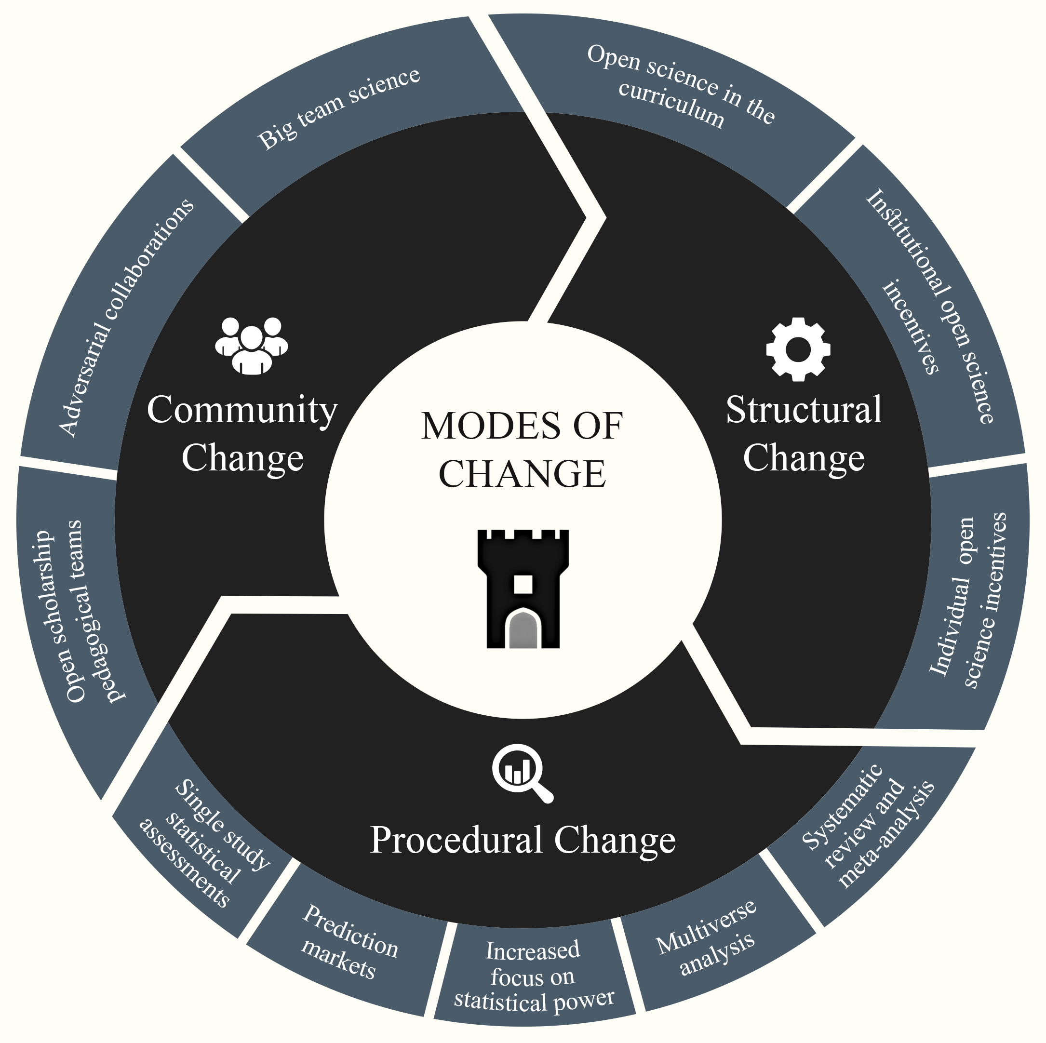
The replication crisis has led to positive
structural, procedural, and community
changes
https://doi.org/10.1038/s44271-023-00003-2

Slide 3

The road to the Replication Crisis
Background
____________
Up to the 2010s, the focus of many scientific communities was on novelty & discovery.
While those are great objectives, paired with a lack of emphasis upon transparency and rigor in how to conduct studies and analyse data, this would later lead to many unstable/non-robust findings.
Notes:
The focus on novelty and discovery is an important part of scientific endeavour. It allows to bring a field forward, question concepts which have been by doing things differently or by introducing new insightful ways of understanding the world.
While these are great objectives, it is equally important to produce robust findings. Robust means that the findings hold, even when changing certain parameters around the findings (for example conducting the study in a similar sample at a different place) or ways of analysing the data. With other words, we want to produce findings we can trust, and which are as telling as possible for as many people in the world as possible, which refers to the generalisability of the findings.
For a long time, statisticians have outlined how to conduct and report studies to get robust findings and standards continue to evolve. For example, Cohen has already described the importance of statistical power and effect sizes in the 1980s (Those are concepts we will come back to later), e.g., in his 1988 book Statistical Power Analysis for the Behavioural Sciences. Standards for ensuring appropriate sample sizes and how to report statistics have changed.

Slide 4
The road to the Replication Crisis
Background
____________
Lack of standards + publishing pressures (novel findings) =
Some not so good studies.
Often used example in psychology: Bem (2011) claiming that people can predict an undecided 50/50% future event (p < .05) more that would be expected by chance
Notes:
So, to some degree, there was a lack of established standards, for example, analysing data a certain way. Adding to this was the pressure to publish novel findings.
Why were novel findings published more? Because they were considered interesting, sexy and thus more often read. They were considered more desirable and journal editors often used this as an evaluation criteria when deciding whether to publish a manuscript. Novelty clearly doesn’t equate to quality/rigor and this prioritisation of novelty prevents the build up of evidence towards areas of consensus which can be most impactful for policy impact.
Unfortunately, the focus on novelty and a lack of guidelines and hence understanding of statistics lead to many practices which introduce false positives - claims that effects existed when they don't. For example, false positives can be induced by the way data are analysed. Namely, when strictly trying to reject a null hypothesis (H0), it is important to do so by analysing the data once, not many times excluding some data points each time, or some condition to finally find a significant effect, unless the alpha-level is corrected. That will say, that we would need a lower p-value to call a finding significant (as the alpha level becomes lower when conducting multiple tests on the same hypothesis). For example, instead of requiring p-values at the common threshold of p<0.05, we could divide alpha by the number of tests (e.g., with 5 tests, we can call p<.01 significant).
You see that there are many different ways researchers could muddle with the analysis process, such as conducting many analyses, but only reporting significant results, or hypothesising after knowing the results. All the possible freedoms researchers have were also called researchers’ degrees of freedom. The misuse of researchers’ degrees of freedom was later also labelled “questionable research practices”, which resulted in the publication of some wild findings. The probably most notable of these papers was in the prestige journal JPSP by Bem (2011) on “precognition”, the ability to see into the future. Indeed, it was claimed that participants could predict a yet undecided 50/50 event. An impossibility? Not when introducing false positives into the data by analysing the data so long until a significant finding pops up somewhere and then only reporting this one analysis while discarding all others (and not considering them).

Slide 5
A Replication Crisis?
Background
____________
So, how to know what we know?
One attempt: replications.
The most prominent example comes from psychology: A 100-study replication study showed low rates of subjectively labelled replicability (39%) and effect sizes among these half the original.
Notes:
Studies like Bem’s caused controversy and it was not clear anymore whether it was possible to trust psychological findings. It was however also not clear how to verify findings, as replication studies were not welcomed by most journals. You might guess why. They were not novel.
Replication studies refer to testing a previously reported effect in a different sample. This can be done conceptually (more loosely) by capturing the effect in a different way to that originally reported (i.e., using different operationalisations, data processing and statistical approaches and/or different constructs; LeBel et al., 2018). Alternatively, replications are done as close to the original study as possible. There are ongoing discussions on how close replications can be to the original, and how to interpret them.
However, at the time, replications were sparse and offered an opportunity to assess the state of psychological science. The Open Science Collaboration (2015) provided for the first time an overview of replications of 100 highly cited study with results which suggested that many effects would not replicate the way one would have imagined.
Now, there was much discussion on whether this is a replication crisis or better described in another way. Yet, it was overall clear that the practices and circumstances which had lead up to this situation were sub-optimal, and there were several well-embedded problems to be addressed.

Slide 6
Learning from the Replication
Crisis
Background
____________
Replication problems can be found in many fields.
E.g. psychology, cancer biology or economy
Notes:
Now, we started talking about the replication crisis in psychology, but many, perhaps most fields show replication problems. Of course, the same practices and incentive/publication system apply to other fields than psychology.
Since the large-scale replication effort in 2015 by the Open Science Collaboration, many more replications were done showing differential patterns across disciplines. This has even been demonstrated in areas considered more aligned to scientific study e.g., cancer biology.

Slide 7
Learning from the Replication
Crisis
Background
____________
Examples of subjectively labelled replication rates:
Psychology: 64% successfully replications, with effect sizes being 32% smaller than the original effects
Cancer biology: 47%successfully replications, 92% of the effects were smaller than original effects
Economy: 61% successfully replications, 34% effect size shrinkage
Notes:
Replication rates refer to subjectively labelled replication “success” or outcomes. This translates usually to a binary of successful and unsuccessful. However, there are many dimensions to replication outcomes. For example, an effect might reproduce, but be much weaker. Is the replication successful? (Usually, the answer would be yes.). What if the study can be only be partially be reproduced (only some effects or only in specific samples or under specific conditions)?
There are several larger replication projects:
Psychology (https://doi.org/10.1146/annurev-psych-020821-114157)
Cancer biology (https://doi.org/10.7554/eLife.71601)
Economy (https://doi.org/10.1126/science.aaf0918)
And we could go on and on with such replication projects, showing similar trends of a certain proportion of findings not replicating. So, the replication crisis is absolutely not unique to psychology or even the social sciences (see cancer biology example).
Now, let’s jump to 2023.

Slide 8

Learning from the Replication
Crisis
Background
____________
For a more detailed overview of the replication crisis and open science practices see Charlotte Pennington’s “Students Guide to Open Science.”
Notes:
For more details on both the replication crisis and what has happened in response to it see this very accessible book. Especially recommended for students.

Slide 9
Learning from the Replication
Crisis
The Problem
____________
Literature assessing the Replication Crisis has focussed on identifying what’s wrong (e.g., questionable research practices and unhealthy structures). This is where the discussion often stops.
Yet, there is much opportunity in learning from mistakes and improving. To move forward, positive change needs to be acknowledged, encouraged, and build upon.
Notes:
We have seen that replication studies produced different results, dependent on the study and field. Overall, replication rates were lower than expected which subsequently led events to be labelled a replication crisis.
The field’s (psychological science) logical reaction was to identify how we got there. Many questionable research practices and unhealthy structures (for example within the publishing system) were identified.
Unfortunately, the discussion often ends on the things one is not allowed to do. On mistakes others learned.
These mistakes and shortcomings are incredibly important to inform future choices and learning, and they need to be acknowledged. However, also the positive change, all that has happened and resulted in feasible, practically applicable solutions needs acknowledging.

Slide 10
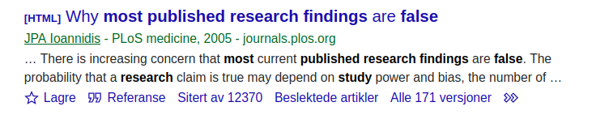
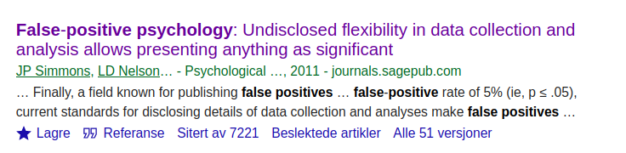
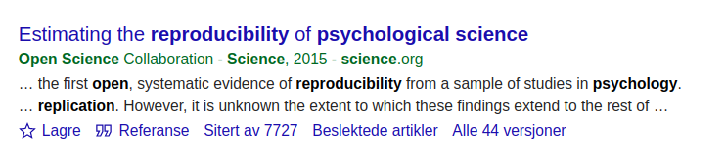
Learning from the Replication Crisis
The most cited studies in the context of the Replication Crisis outline the problem. The next logical step is to move towards solving the problem / crisis.
Notes:
Here, just some of the most prominent papers on the replication crisis illustrating the point: the focus has been on outlining the problem(s). This was necessary at the time as the field needed to understand that change is required.
However, the way towards solving the crisis and doing so in a sustainable fashion certainly needs attention too. This is where the paper “The replication crisis has led to positive structural, procedural, and community changes” comes in.

Slide 11
Credibility Revolution
Keeping the opportunity for change in mind, Simine Vazire coined the term Credibility Revolution instead.
Key characteristics of the Credibility Revolution:
greater emphasis on transparency and openness
a move toward preregistration of research
more direct-replication studies
higher standards for the quality and quantity of evidence needed to make strong scientific claims
Vazire (2018). Perspectives on Psychological Science.
Notes:
It seems logical to see the replication crisis as a great learning opportunity and a chance to improve upon (considering all the suggestions on how to improve scientific practice as a result of the crisis).
Within this framework of thinking, Simine Vazire came up with a potentially more helpful term describing the replication crisis: a credibility revolution. This term contains first of all the hope to being able to revolutionise some outdated practices and structures and replacing them with new and better alternatives. Secondly, the term refers to credibility which suffered across scientists and even influenced the perceptions of the general population. In short, the term invokes hope.
Vazire further suggest various key concepts which characterised the credibility revolution so far (2018):
greater emphasis on transparency and openness
a move toward preregistration of research
more direct-replication studies
higher standards for the quality and quantity of evidence needed to make strong scientific claims

Slide 12
Credibility Revolution
In other words, the change is already happening. A resource structuring and presenting the developments has just been lacking.
Notes:
The change described by Vazire is already happening, but it has been cumbersome to get the right info on the details of what is happening, how these changes are implemented practically. Simply put, it’s easy to miss out on some of the big positive changes by reflecting upon the progress still yet to be made.
Furthermore, the open science or science reform movement is moving. Developments are ongoing. Within the recent years, the developments towards a more open science have been cumulative.
We provide a conceptualisation of how the change happens: https://doi.org/10.1038/s44271-023-00003-2
The paper is supposed to be a resource which makes it easier to access the topic of the replication crisis & what to with it.

Slide 13
Organising Change
Structural, procedural and community-level change as a consequence of the replication crisis.
Korbmacher et al. (2023). Communications Psychology
Notes:
One way of structuring positive developments as a result of the replication crisis or credibility revolution is to classify by structural, community, and procedural change.
There are some general trends which can be noticed when reviewing the literature:
- an increased focus on working in teams (community level)
- methods and statistical procedures and tools which individuals could use (procedural level)
- normalisation of open science through policies and incentives (structural level)
The following sections will discuss the identified changes in each domain of change (structures, community-actions, and procedures).

Slide 14
Structural Change
Curriculum changes
Implementing Open Science Practices in the curriculum
Replication studies as theses
Notes:
Much has changed in recent years on how methods and statistics are taught.
This can be generally summarised in two major changes:
Implementing Open Science Practices in the curriculum
Implementing replication studies as theses
Open Science or Open Scholarship Practices reflect the idea that scientific knowledge of all kinds, where appropriate, should be openly accessible, transparent, rigorous, reproducible, replicable, accumulative, and inclusive. Open science consists of principles and behaviours that promote transparent, credible, reproducible, and accessible science. Open science has six major aspects: open data, open methodology, open source, open access, open peer review, and open educational resources.
In the following, there will be a closer presentation on how a scheme for replication studies can be implemented.

Slide 15
Structural Change
Curriculum changes
Implementing Open Science Practices in the curriculum
Creating norms of Open Science usage (instead of exceptions)
Large collection of open source teaching and learning materials
Replication studies as theses
As part of large-scale collaborations
As single studies (publication with the help of ECRs)
Notes:
Creating Norms
Learning about open scholarship practices influences how students approach science, both as a researcher or a consumer of research.
This includes:
Knowledge, expectations, attitudes, and engagement toward becoming more effective and responsible researchers and consumers of science.
Personal values connected to research.
Being better equipped to make rigorous scientific contributions.
Fostering equity and justice, breaking down status hierarchies and power structures (e.g., decolonisation, diversity, equity, inclusion and accessibility efforts)
Overall, open science skills foster critical thinking, which is a core element of the university education across disciplines.
The increasing uptake of Open Science related topics into the curricular aid the development of open science practices becoming the norm.

Slide 16
Structural Change
Curriculum changes
Implementing Open Science Practices in the curriculum
Creating norms of Open Science usage (instead of exceptions)
Large collection of open source teaching and learning materials
Replication studies as theses
As part of large-scale collaborations
As single studies (publication with the help of ECRs)
Notes:
Creating knowledge bases
Various efforts to increase the adoption of open scholarship practices into the curriculum are being undertaken by pedagogical teams with the overarching goal of increasing research rigour and transparency over time.
The contributions generally split into three (overlapping) parts of providing …
Resources
Guidelines
Community
Since there is a breadth of tasks required in the pedagogic reform towards open scholarship, there are many teams and organisations specialising on particular portions of the reform. Just a few examples:
Meta science, research transparency, reproducibility, rigour, social justice, and ethics [Framework for Open and Reproducible Research Training (FORRT)]
Syllabi [Course Syllabi for Open and Reproducible Methods; Carpentries]
Journal clubs discussing open science [ReproducibiliTea]
Open Science events [RIOT Science Club]
Who is behind these efforts?
While these changes are structural, they are often driven by early career researchers.
(Unfortunately, often receiving little recognition for their contributions).

Slide 17
Structural Change
Curriculum changes
Implementing Open Science Practices in the curriculum
Creating norms of Open Science usage (instead of exceptions)
Large collection of open source teaching and learning materials
Replication studies as theses
As part of large-scale collaborations
As single studies (publication with the help of ECRs)
Notes:
Higher Education instructors and programmes have begun integrating open science practices into the curriculum at different levels.
There are currently two presented ways of implementing replications as thesis:
Thesis replications as part of large-scale collaborations
Thesis replications as single studies (publication with the help of ECRs)
We start with the first one.
Replication studies in large-scale collaborations
There is one prominent “consortium approach”, by the Collaborative Replications and Education Project, which integrates replications in undergraduate courses as coursework with a twofold goal:
educating undergraduates to uphold high research standards
simultaneously advancing the field with replications
This approach requires a consortium of supervisors and their students who collaborate.
The procedure is typically the following:
1) Selection of the most cited studies from the most cited journals in the last three years
2) Administrative advisors rate the feasibility of the replication to decide whether to run the study across the consortium of supervisors and students.
3) Study is conducted by students.
4) After study completion, materials and data are submitted and used in meta-analyses, for which students are invited as co-authors.

Slide 18
Structural Change
Curriculum changes
Implementing Open Science Practices in the curriculum
Creating norms of Open Science usage (instead of exceptions)
Large collection of open source teaching and learning materials
Replication studies as theses
As part of large-scale collaborations
As single studies (publication with the help of ECRs)
Notes:
Single replication study publications
Another options is to implement independent/single replication study theses.
The approach of selecting replication targets can be similar to the one described before (based on citations) or on supervisors’ & students’ interest.
However, in order to make sure that the replication studies also make it into the literature, extra effort is necessary. One can either ask other investigators to bring the dissertation to publication (e.g., early career researchers), or set up a scheme in which students publish the replications themselves.
Registered reports is a useful format for such replication efforts, as they allow for a review of the study before data are collected (stage one of a two-stage process). Students can submit a thesis based on the submission.

Slide 19
Structural Change
Incentives
Targeting Researchers
Targeting Journals & Funders
Notes:
The third side of structural changes are incentives.
These can be categorised into incentives which target
Researchers, and
Journals & funders.

Slide 20
Structural Change
Incentives for researchers
Badges
Registered Reports
Incentives for journals & funders
Transparency and Openness Promotion (TOP) and other guidelines and factors for journals
Plan-S (EU-wide open publishing)
Re-designed peer review (e.g., PeerCommunityIn)
Research evaluation updated (e.g., San Francisco Declaration of Research Assessment)
Notes:
Incentives for researchers
Badges are now awarded in some journals for open science practices (including open data, code, materials, preregistration) with the aim of signalling study quality
Registered reports
Allow for a “in-principle acceptance” before collecting data
That makes sure to save resources by
1) Ensuring quality of the research by reviews during an early stage of the projects
2) Ensure publication independent of the results.
Studies on registered reports generally suggest that these studies are conducted with more rigor than non-registered reports

Slide 21
Structural Change
Incentives for researchers
Badges
Registered Reports
Incentives for journals & funders
Transparency and Openness Promotion (TOP) and other guidelines and factors for journals
Plan-S (EU-wide open publishing)
Re-designed peer review (e.g., PeerCommunityIn)
Research evaluation updated (e.g., San Francisco Declaration of Research Assessment)
Notes:
Incentives for journals and funders
There are multiple incentives provided for journals and funders to take up open science practices.
These can be grouped by several guidelines which have been widely adopted, such as the Transparency and Openness Promotion (TOP) guidelines by the center for open science comprising eight modular standards to reflect journals’ transparency standards:
Citation standards
Data transparency
Analytic methods transparency
Research materials transparency
Design and analysis transparency
Study preregistration
Analysis plan preregistration
Replication

Slide 22
Structural Change
Incentives for researchers
Badges
Registered Reports
Incentives for journals & funders
Transparency and Openness Promotion (TOP) and other guidelines and factors for journals
Plan-S (EU-wide open publishing)
Re-designed peer review (e.g., PeerCommunityIn)
Research evaluation updated (e.g., San Francisco Declaration of Research Assessment)
Notes:
Incentives for journals and funders
Plan-S for
Mandates open publishing when the research is funded by public grants
Increase in open access options illustrates how journals are being effectively incentivized to expand their repertoire and normalize open access
Potential issue which yet has to be resolved: article processing charges have increased, causing new forms of inequities

Slide 23
Structural Change
Incentives for researchers
Badges
Registered Reports
Incentives for journals & funders
Transparency and Openness Promotion (TOP) and other guidelines and factors for journals
Plan-S (EU-wide open publishing)
Re-designed peer review (e.g., PeerCommunityIn)
Research evaluation updated (e.g., San Francisco Declaration of Research Assessment)
Notes:
Incentives for journals and funders
New peer-review models, e.g., PeerCommunityIn
Relatively new system in which experts review and recommend preprints or registered reports to journals
Another suggestion: the journal eLife abolishes accept/reject decisions once a paper goes into peer review

Slide 24
Structural Change
Incentives for researchers
Badges
Registered Reports
Incentives for journals & funders
Transparency and Openness Promotion (TOP) and other guidelines and factors for journals
Plan-S (EU-wide open publishing)
Re-designed peer review (e.g., PeerCommunityIn)
Research evaluation updated (e.g., San Francisco Declaration of Research Assessment)
Notes:
Incentives for journals and funders
New research evaluation models
Fundamental problem: focus on flawed metrics such as the impact factor when evaluating applications to positions or grants
Declarations to update such assessments:
San Francisco Declaration of Research Assessment (DORA)
Coalition for Advancing Research Assessment (CORA)
Emphasis on considering all research outputs, including software and data, and considering the qualitative impact of research, such as its policy or practice implications.

Slide 25
Procedural Change
Predictions Markets
Several prediction market studies show that experts and non-experts can predict study replicability
Hence, another tool for researchers to assess the credibility of existing and hypothetical works
Notes:
We start with prediction markets, which have recently been proposed to be useful to assess research credibility through expert or lay-people assessments.
Usually assessments of replicability of certain claims
Large prediction market projects such as the repliCATS project have yielded replicability predictions with high classification accuracy (between 61% and 86%)
Replication markets offer yet another tool for researchers to assess the credibility of existing and hypothetical works
In that sense, it is an ongoing discussion whether low credibility estimates from replication markets can be used to inform decisions on which articles to replicate

Slide 26
Procedural Change
Statistical assessments
Assessing sets of studies: Focus on α- and β-levels (Type I and II error rates) & distribution of p-values
Assessing single studies; Automatic numerical error and inconsistency detection
Notes:
One can assess either a body of studies or statistical parameters within single studies.
Let’s start with methods addressing a whole body of studies.
Sets of studies
Failure to control error rates and design high-power studies can contribute to low replication rates.
Hence, development of various quantitative methods to assess expected distributions of statistical estimates (i.e., p- or Z-values)
P-curve: measuring the deviation from an expected uniform distribution of p-values considering a true null hypothesis
Z-curve: like p-curve, but assessing the distribution of test statistics while considering the power of statistical tests and false discovery rate within a body of literature
Such estimations of bias in the literature identify selective reporting trends and help establish a better estimate of whether replication failures may be due to features of the original study or features of the replication study
Assessments of different sets of studies generally shows publication bias = non-significant findings are under-reported, leading to a distorted representation of the actual effects in the literature
Another solution: lower α-levels to 0.005 or abolishing it entirely
It is also possible to justify the alpha level based on the executed study & in regard to the magnitude of acceptable Type I versus Type II errors
One can also collect evidence using
Equivalence tests, or
Bayesian analysis

Slide 27
Procedural Change
Statistical assessments
Assessing sets of studies: Focus on α- and β-levels (Type I and II error rates) & distribution of p-values
Assessing single studies: Automatic numerical error and inconsistency detection
Notes:
Assessing single studies
When assessing single studies, there are different tools which can easily check for mathematical inconsistencies and impossibilities.
Two examples are
Granularity-Related Inconsistency of Means (GRIM) test: evaluates the consistency of mean values of integer data (e.g., from Likert-type scales), considering sample size and the number of items
Sample Parameter Reconstruction via Iterative TEchniques (SPRITE): reconstructs samples and estimates of the item value distributions based on reported descriptive statistics
Adopting these efforts can serve as an initial step in reviewing existing literature, to ensure that findings are not the result of statistical errors or potential falsification.
Researchers themselves can implement these tools to check their work and identify potential errors.
With greater awareness and use of such tools, we can increase accessibility and enhance our ability to identify unsubstantiated claims.

Slide 28
Procedural Change
Multiverse analysis
There is nearly never a single correct way of analysing a dataset
Instead, there is a multiverse
Multiverse analysis incorporates as many sensible ways as possible
Notes:
Researcher degrees of freedom—i.e., decisions researchers can make when using data—have been shown to influence the outcomes of analyses performed on the same data
In more complex data, e.g., in neuroimaging, no one analysis pipeline is like the other (potentially not even within the same lab)
The scientific process involves numerous analytical decisions that are often taken for granted as non-deliberate actions following established procedures but whose cumulative effect is far from insignificant.
Even in a research setting with high accuracy motivation and unbiased incentives, reliability between researchers may remain low, regardless of researchers’ methodological expertise
Multiverse analysis or its sibling sensitivity analysis can offer solutions to these challenges

Slide 29
Procedural Change
Systematic review and meta-analysis
Guides and resources on reproducible reviews and meta analyses addressing two major problems:
Bias in the literature
Researchers’ degrees of freedom in methodological choices
Notes:
Data synthesis from several primary studies can be done by systematic reviews and meta-analyses
Problem 1: biassed literature (e.g, due to prioritisation of novelty or statistically-significant results)
Can be observed (to a certain extent) using funnel plots in meta-analyses
Problem 2: researcher degrees of freedom in determining inclusion criteria, methodological approaches, and the rigour of the primary studies
Solution: development of best practices for open, and reproducible systematic reviews and meta-analyses such as
Preferred Reporting Items for Systematic Reviews and Meta-Analyses (PRISMA)
Non-Interventional, Reproducible, and Open (NIRO) systematic review guidelines
The Generalized Systematic Review Registration Form
PROSPERO, a register of systematic review protocols
Guidelines often include a risk of bias assessment, where different biases are assessed and reported
Remaining problem: most systematic reviews and meta-analyses do not follow standardized reporting guidelines
Hope for the future: increased uptake of guidelines in articles and as journal submission requirements

Slide 30
Community Change
Adversarial Collaborations & Big Team Science
Crowdsourced research & distributed networks of research teams facilitate large-scale investigations
The same holds true for error checking each other and constructive critiquing (red teams and adversarial collaborations)
Science acceleration through cooperation
Notes:
Community change encompasses how work and collaboration within the scientific community evolves. We describe two of these recent developments: Big Team Science and adversarial collaborations.
Big team science
What is big team science?
Large-scale, collaborative communities working on a scholarly common goal and pooling resources across labs, institutions, disciplines, cultures, and countries
Big teams can have different goals, such as mass replications (e.g., the Open Science Collaboration, Many Labs) or cross-cultural and robust research (e.g., Psychological Science Accelerator)
How does big team science make a contribution to the scientific field?
Leverages the resources and knowledge of many scientists
Institutionalisation of good scientific practices to improve research quality, including:
interdisciplinary internal reviews,
incorporating multiple perspectives,
implementing uniform protocols across participating labs, and
recruiting larger and more diverse samples
The latter also extends to researchers themselves: Big Team Science can increase representation, diversity, and equality and allow researchers to collaborate by either coordinating data collection efforts at their respective institutions or by funding the data collection of researchers who may not have access to funds & by accrediting labour correctly

Slide 31
Community Change
Adversarial Collaborations & Big Team Science
Crowdsourced research & distributed networks of research teams facilitate large-scale investigations
The same holds true for error checking each other and constructive critiquing (red teams and adversarial collaborations)
Science acceleration through cooperation
Notes:
Adversarial collaborations
Scholarly critique typically occurs after research has been completed
Review
Comments to an article
Blogs
However, more helpful before the research is conducted and the article is written
Here, adversarial collaborations can offer a consensus-based resolution of scientific debates
Researchers with differing viewpoints collaborate to facilitate more efficient knowledge production and self-correction by reducing bias
Red teaming
Similar to adversarial collaborations, but more focussed on error finding
Inspired by the world of software development where bugs in the code are found
This approach can be used for analyses and scripts
However, whether these initiatives contribute to research that is less biased in its central assumptions depends on wherein the “adversarial" nature lies.
For example, two researchers may hold the same biased negative views towards one group, but opposing views on the implications of group membership on secondary outcomes. An adversarial collaboration from the same starting point pitching different methodological approaches and hypotheses about factors associated with group membership would still suffer from the same fundamental biases.

Slide 32
Expanding structural, procedural and community changes
Generalizability
Formal theory building
Qualitative research
Diversity and inclusion
Notes:
To expand the developments discussed and to address current challenges in the field, we can now discuss a selection of areas that can benefit from the previously described structural, procedural, and community changes:
Generalizability
Theory building
Open scholarship for qualitative research, and
Diversity and inclusion as an area necessary to be considered in the context of open scholarship

Slide 33
Expanding structural, procedural and community changes
Generalizability
Formal theory building
Qualitative research
Diversity and inclusion
Notes:
Generalizability
Extant work outlines the generalizability of effects in psychological research as a serious concern
Reason/the problem:
Traditionally, variables such as stimuli, tasks, or contexts were ignored when generalising findings
Methodological variation can be partially achieved through statistical estimation (e.g., including random effects of stimuli in models)
Also acknowledging and discussing study limitations represent an option
HOWEVER unmeasured variables, stable contexts, and narrow samples still present substantive challenges to the generalizability of results
Solutions:
Big team science: large, diverse samples, methodological knowledge (expert pooling)

Slide 34
Expanding structural, procedural and community changes
Generalizability
Formal theory building
Qualitative research
Diversity and inclusion
Notes:
Formal Theory building
Replication crisis has been suggested as a theory crisis instead
Low rates of replicability may be explained in part by the lack of formalism and first principles
E.g., 1) improper testing of theory or failures to identify auxiliary theoretical assumptions
2) verbal formulation of psychological theories and hypotheses cannot always be directly tested with inferential statistics
Potential solutions?
Moving away from broad, unspecific claims and theories towards specific quantitative tests that are interpreted with caution and increased weighting of qualitative and descriptive research (Yarkoni, 2022)
Formalising theories as computational models and engaging in theory testing rather than null hypothesis significance testing (Oberauer & Lewandowsky, 2019)
Step-by-step solution suggestion (Devezer et al., 2021)
(1) Define variables, population parameters, and constants involved in the problem, including model assumptions
(2) Formulate a formal mathematical problem statement
(3) Results are used to interrogate the problem
(4) If the claims are valid
(4a) Examples can be used to present practical relevance, while also
(4b) Presenting possible extensions and limitations.
Finally, (5) Policy making recommendations can be given.
Additional discussion of improving psychological theory and its evaluation is needed to advance the credibility revolution

Slide 35
Expanding structural, procedural and community changes
Generalizability
Formal theory building
Qualitative research
Diversity and inclusion
Notes:
Qualitative research
Background
Open scholarship research focused primarily on quantitative data collection and analyses
substantively less consideration for compatibility with qualitative or mixed methods
Barriers to open science in qualitative research
Context-dependent, and labour-intensive features of qualitative research can create barriers, for example, to preregistration or data sharing
some of the tools, practices, and concerns of open scholarship are simply not compatible with many qualitative epistemological approaches (e.g., a concern for replicability)
Privacy concerns
Hence, no one-size-fits-all solution to all qualitative research
New approaches
Various new approaches presented
Protocols
E.g., for preregistration, data sharing, replication studies
Overall, validity, transparency, ethics, reflexivity, and collaboration can be fostered by engaging in qualitative open science
Open practices which allow others to understand the research process and its knowledge generation are particularly impactful here.

Slide 36
Expanding structural, procedural and community changes
Generalizability
Formal theory building
Qualitative research
Diversity and inclusion
Notes:
Diversity and inclusion
Issue: The playing field is not equal for all actors, underlining the need for flexibility that takes into account
Regional differences (e.g., global south)
Marginalised groups (e.g., ethnicity, sex & gender)
Differences in resource allocation when implementing open science practices.
Solutions:
Choosing (preferably free) open access options (incl preprints & post-prints)
Waive article processing charges for researchers from low, or low-and-middle income countries
Pooled funding applications, & re-distributions of resources in international teams of researchers, and international collaborations
On the last point (international collaborations & collaborative efforts)
Big Team Science is a promising avenue to produce high-quality research while embracing diversity; yet, predominantly volunteering-based
Might exclude researchers who do not have allocated hours or funding for such team efforts.
Hence, beyond these procedural and community changes, structural change aiming to foster diversity and inclusion is essential.

Slide 37
Outlook
The credibility revolution motivated structural, procedural, and community changes that would have previously been considered idealistic, if not impractical.
Developments go beyond “fixing failed replications”: transparency, rigor, and quality in all aspects of research are now in the focus
Only change on multiple levels will be sustainable
e.g., researchers focus on high-quality outputs [individual level] but are incentivised to focus on novelty [structural level] sustains old structures & behaviours
Notes:
The credibility revolution motivated structural, procedural, and community changes that would have previously been considered idealistic, if not impractical.
Developments were originally fuelled by failed replications
However, Developments go beyond “fixing failed replications”: transparency, rigor, and quality in all aspects of research are now in the focus
Moreover, replication rates alone may not be the best measure of research quality (and rather transparency & rigour)
Only change on multiple levels will be sustainable
e.g., researchers focus on high-quality outputs [individual level] but are incentivised to focus on novelty [structural level] sustains old structures & behaviours
Multiple positive changes are already implemented and embedded
Hence, we hope to provide our scientific community with hope, and a structure, to make further advances in the crises and revolutions to come.

Slide 38
Outlook
There are other pieces make similar arguments:
Big-Think: Is psychology good for anything? Recent high-profile instances of fraud in psychology have led some to wonder if there's anything useful about the field at all.
Paul Bloom: Psychology is ok. A response to Adam Mastroianni
Notes:
New piece argues that, despite concerns about fraud and replicability, psychology has made important contributions, but like "fish surrounded by so much psychological water, we don’t even notice."

Slide 39




Thank you!
https://forrt.org
info@forrt.org
@FORRTproject
https://doi.org/10.1038/s44271-023-00003-2
Notes:
So, I would like to conclude by saying that FORRT has many other initiatives, so please check our website if you are interested in discovering more initiatives and pedagogies and follow us on Twitter for more updates. I would also encourage you to have a look at our publication page in case you would like to read our more recent publications on open scholarship and open educational resources.
In addition, we always welcome and appreciate new members at any career stage and from any discipline who are interested in open scholarship. If this presentation caught your interest and attention, please join our community in our Slack channel. We would be happy to have you! Thank you very much for your attention and if there are any questions, please feel free to email us.

